Slide 1


Data Analysis

Slide 2


Today's agenda
Project recap
Problem
The Analytics team
Process
Insights
Summary

Slide 3

Social Buzz is a fast growing technology unicorn that need to adapt quickly to it's global scale. Accenture has begun a 3 month POC focusing on these tasks:
An audit of Social Buzz's big data practice
Recommendations for a successful IPO
Analysis to find Social Buzz's top 5 most popular categories of content
Project Recap

Slide 4

OIn
Problem
Over 100000 posts per day
36,500,000 pieces of content per year!
But how to capitalize on it when there is so much?
Analysis to find Social Buzz's top 5 most popular categories of content

Slide 5



ANDREW FLEMING
Chief Technology Architect
The Analytics team
MARCUS ROMPTON
Senior Principal
YOU
Data Analyst

Slide 6
Process
1
Data Understanding
2
Data Cleaning
3
Data Modelling
4
Data Analysis
5
Uncover Insights

Slide 7

Insights
16
1897
JANUARY
UNIQUE CATEGORIES
REACTIONS TO “ANIMAL” POSTS
MONTH WITH MOSTS POST

Slide 8
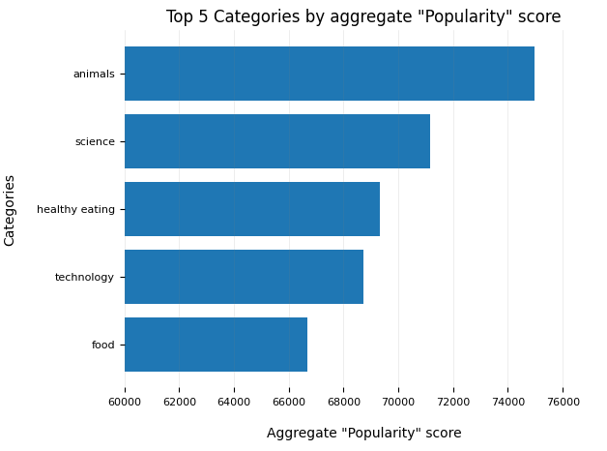
From our analysis, you can see that the top 5 most popular categories of posts were animals, science, healthy eating, technology and food in descending order.
Animals had an aggregate popularity score of around 74965. It is very interesting to see both food and healthy eating within the top 5, it really shows that food is a highly engaging content category. Healthy eating ranks slightly higher than food, so perhaps your user base may be skewed towards healthy eaters and health-conscious people.
Finally, its also interesting to see science and technology too. This may suggest that people enjoy consuming factual content and snippets of content that they can learn something from.

Slide 9
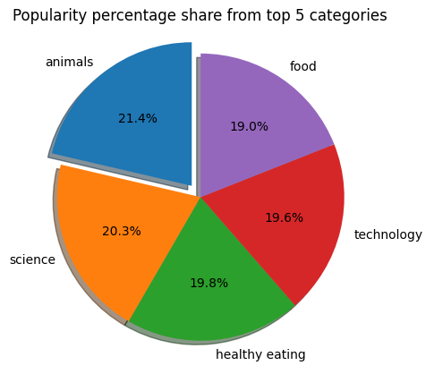
Additionally, you can see from this chart the % split of popularity between the top 5 categories. There is not much difference between the share of each category, however, the difference between the 1st most popular, animals and the 2nd most popular, science, is the largest gap equal to 1.1%.
In business terms, this could suggest that the most popular category, animals, is tailing away from the rest of the categories and may continue to get more and more popular. To avoid an issue where 1 content category consumes the entire platform, it will be important for you to ensure that any algorithms used to govern the content on the platform gives a fair balance to the content categories.

Slide 10

ANALYSIS
Animals and science are the two most popular categories of content, showing that people enjoy "real-life" and "factual" content the most.
INSIGHT
Food is a common theme with the top 5 categories with "Healthy Eating" ranking the highest. This may give an indication to the audience within your user base. You could use this insight to create a campaign and work with healthy eating brands to boost user engagement.
NEXT STEPS
This ad-hoc analysis is insightful, but it's time to take this analysis into large scale production for real-time understanding of your business. We can show you how to do this.
Summary

Slide 11
Thank you!
ANY QUESTIONS?

